Slide 1
How to find the Molecular Imaging Core
10-21-2021

Slide 2
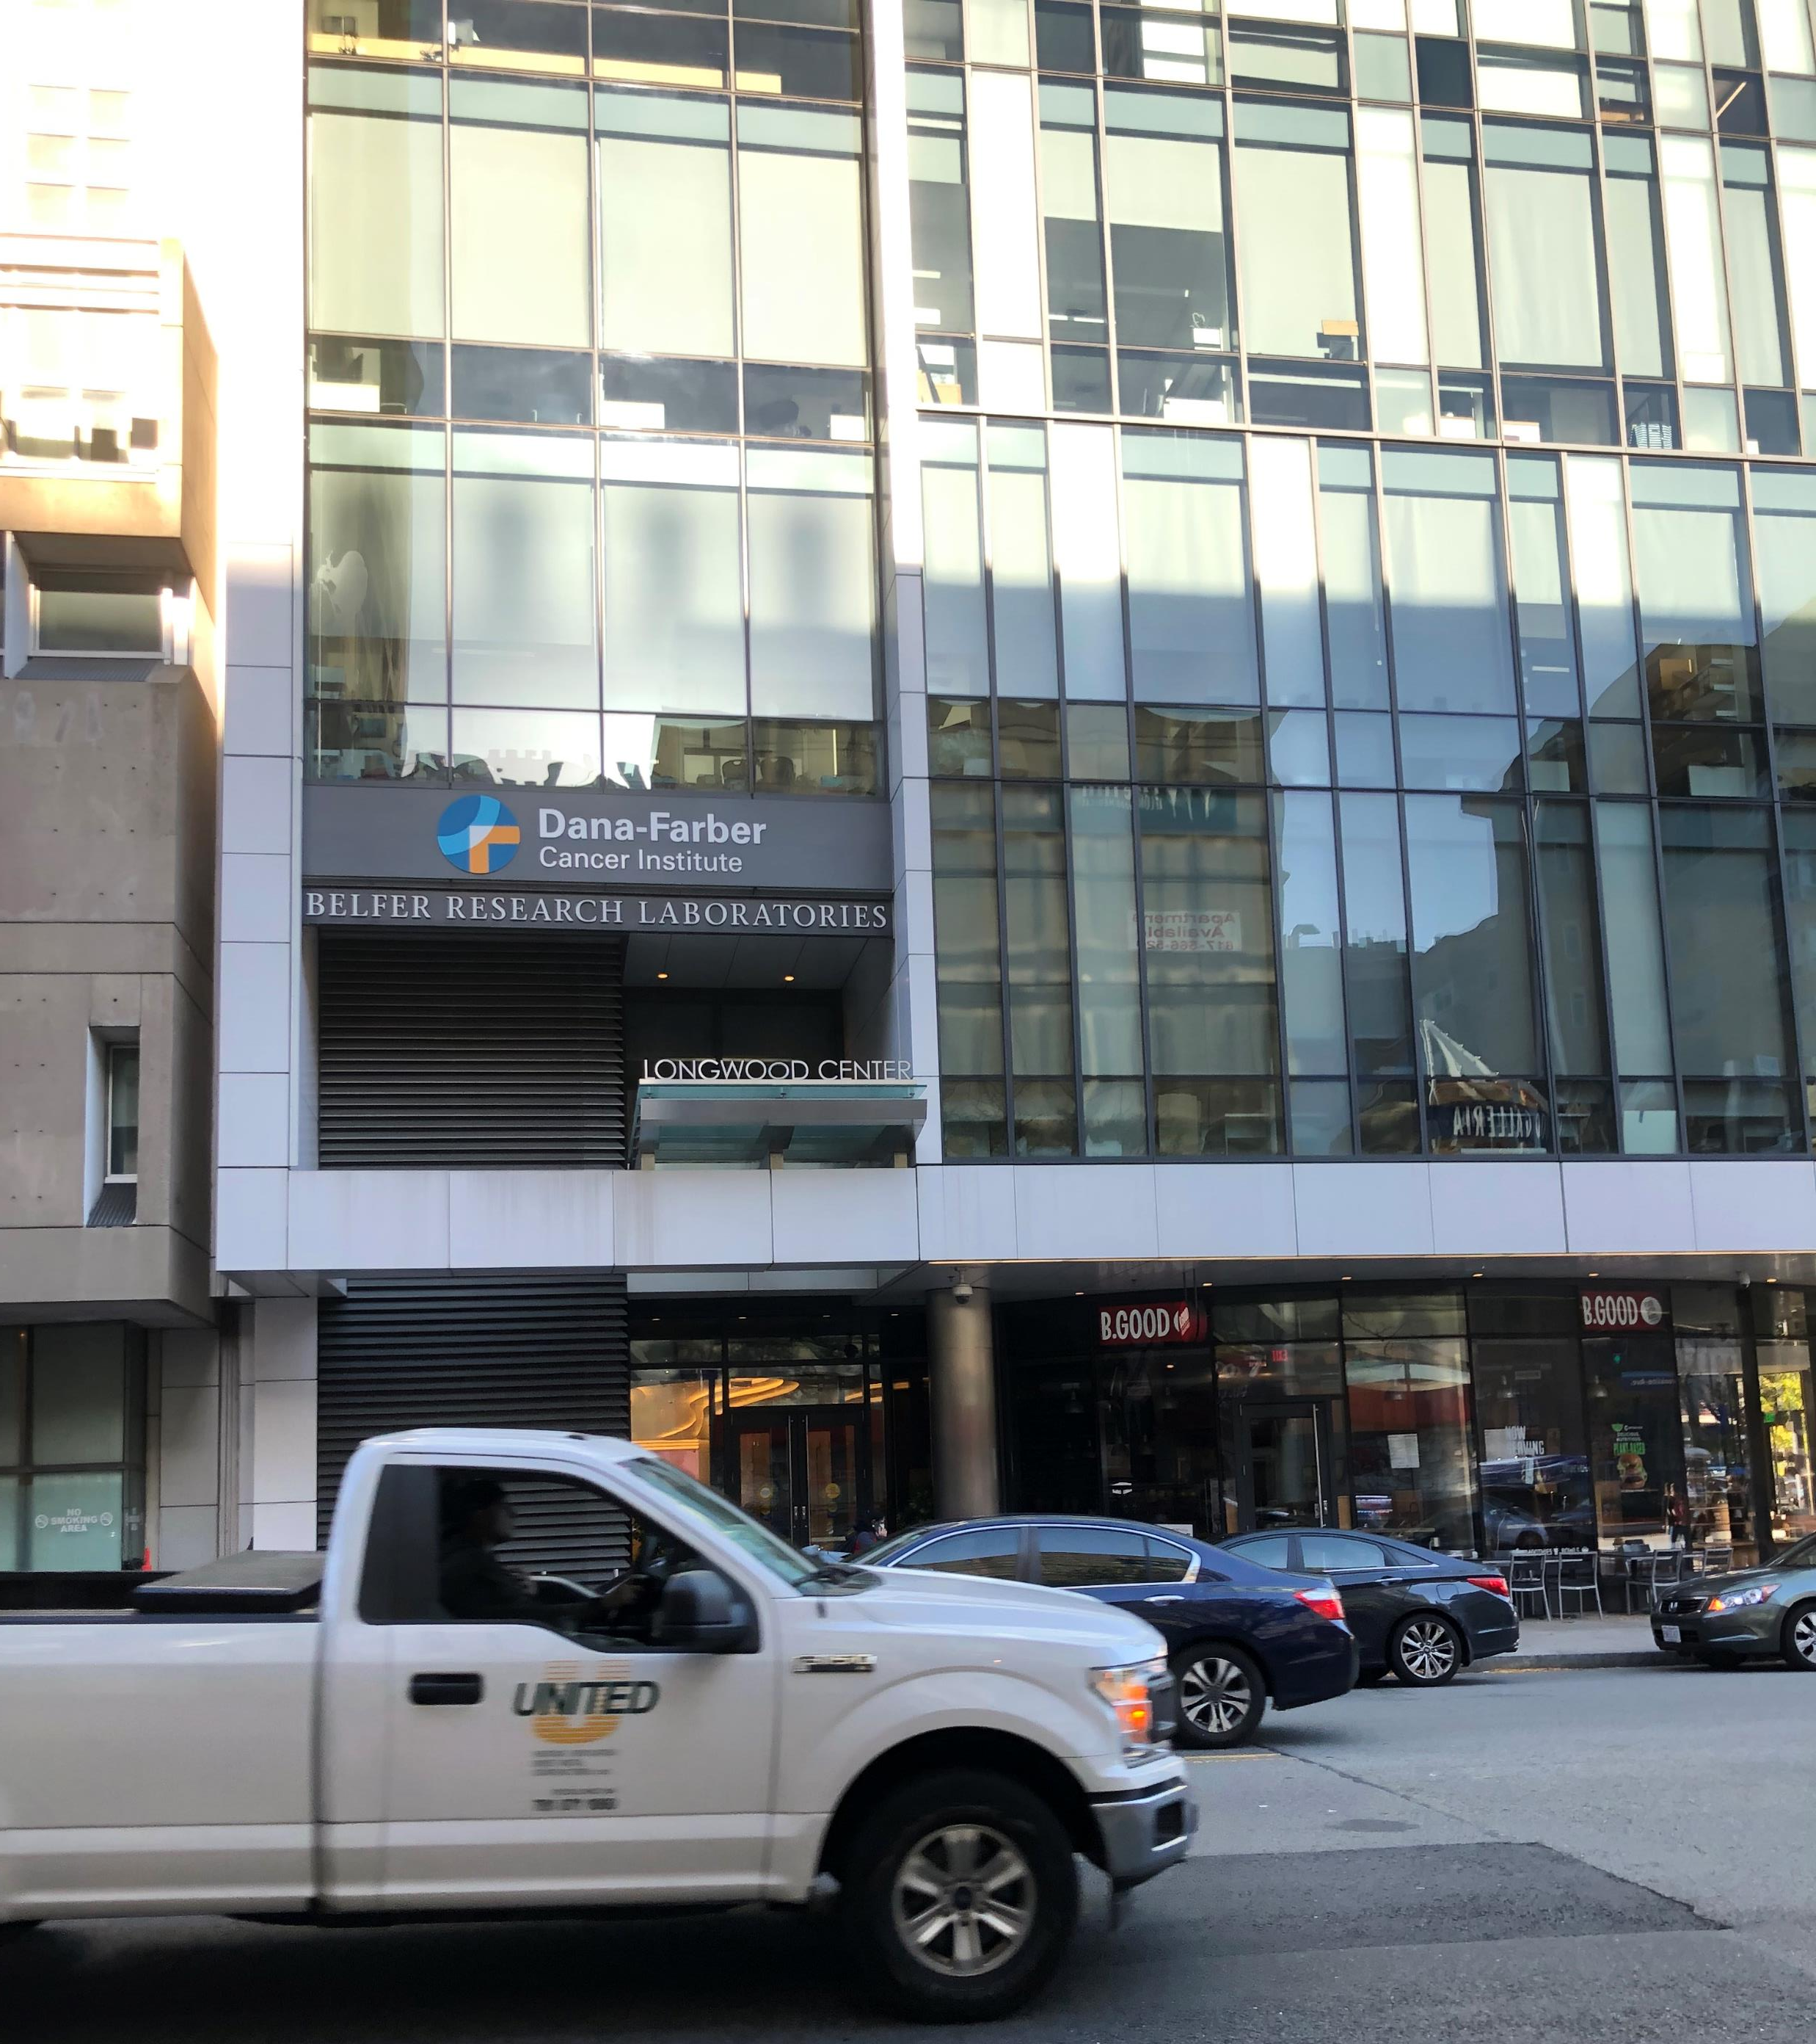
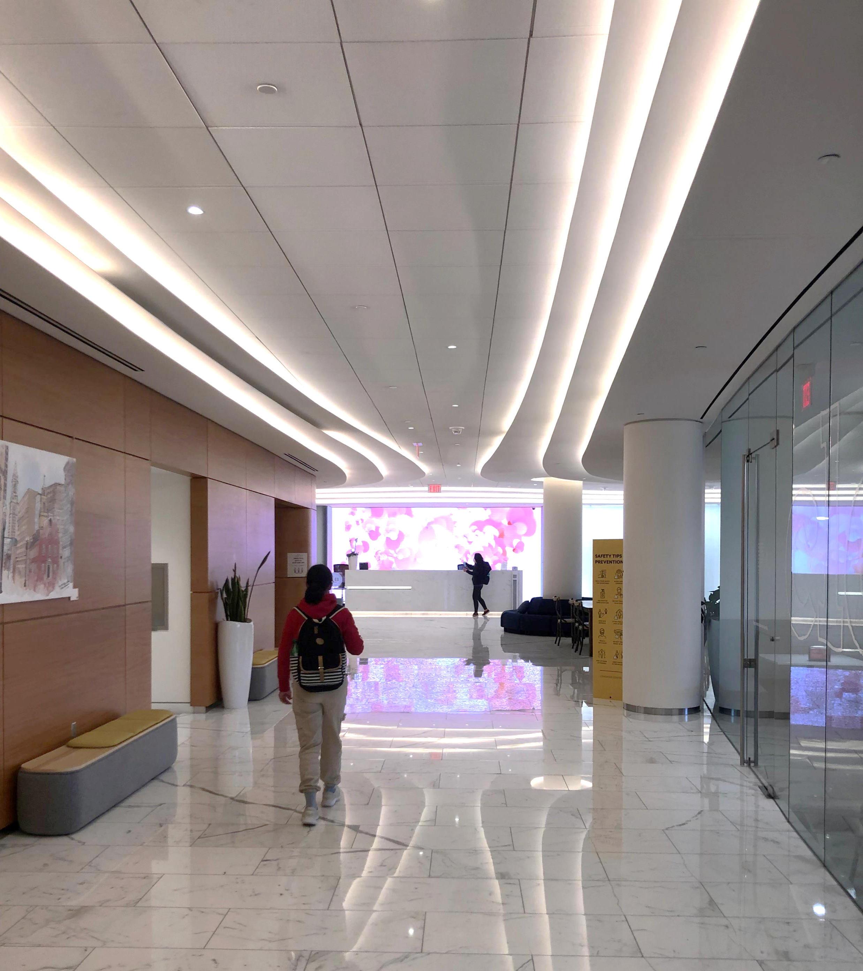
Go towards the end of the hallway
Ask the front desk for help for non-DFCI members
Main entrance

Slide 3
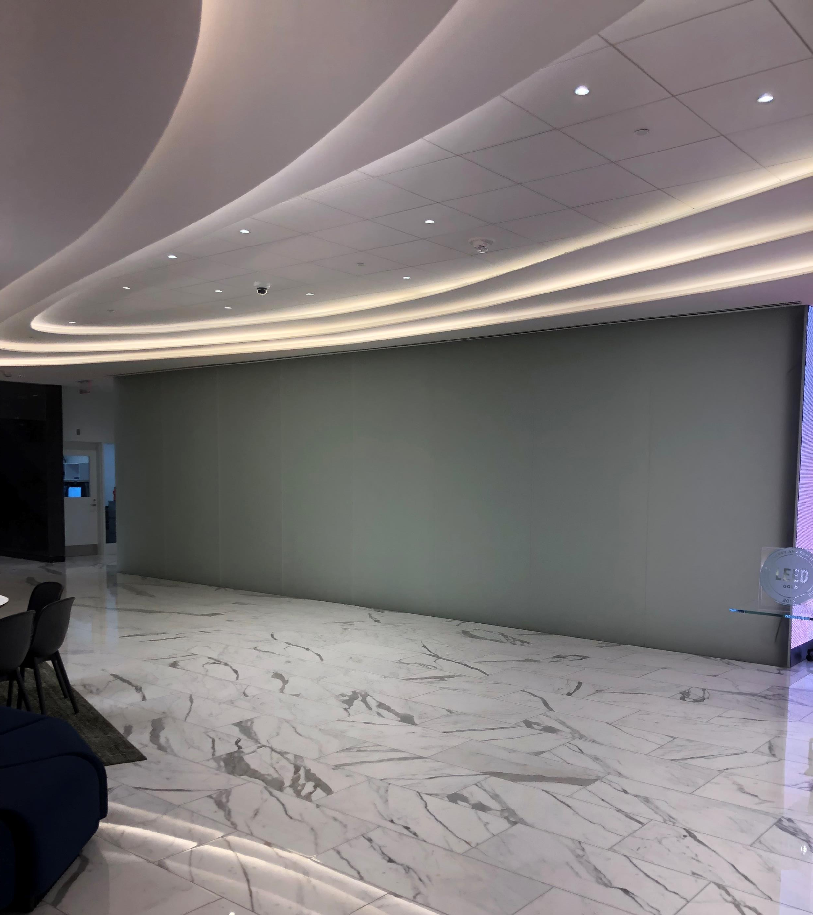
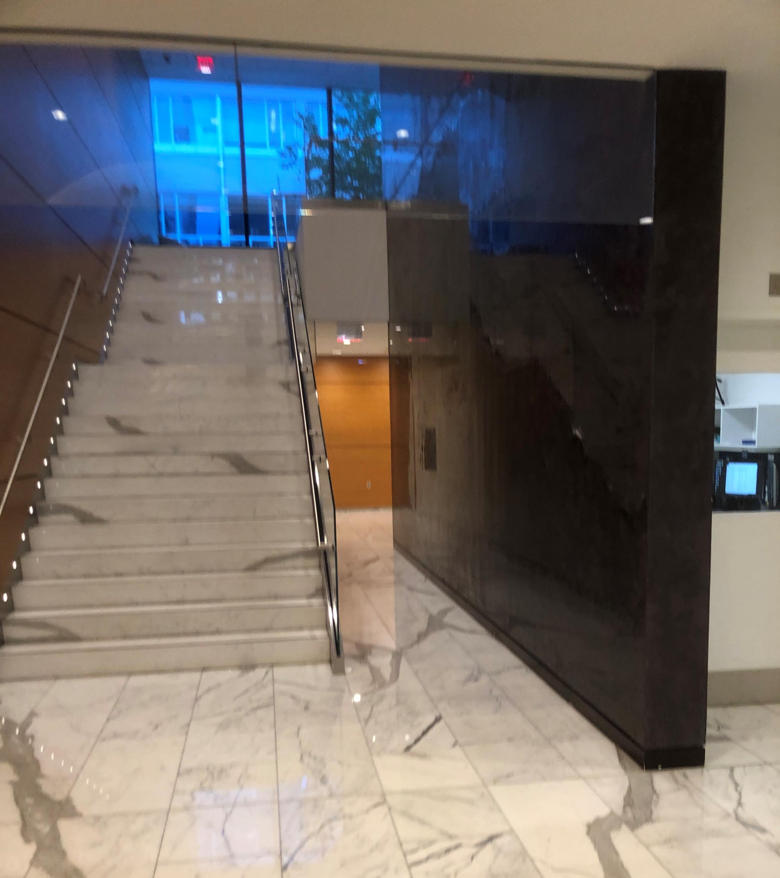
Small path
Small path

Slide 4
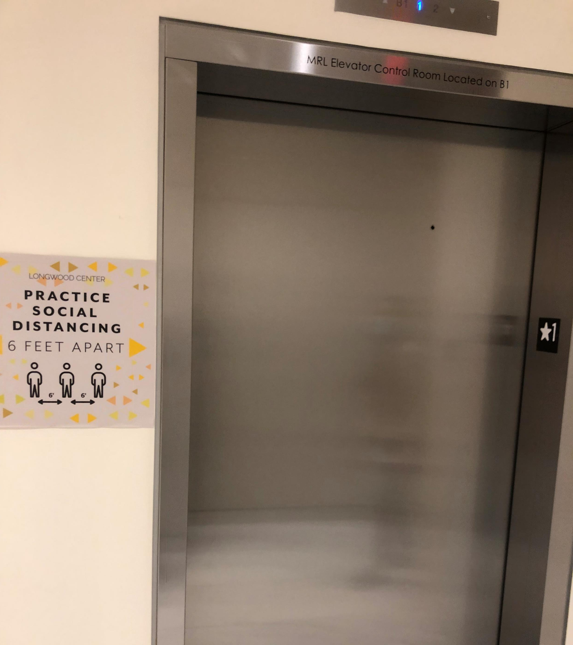
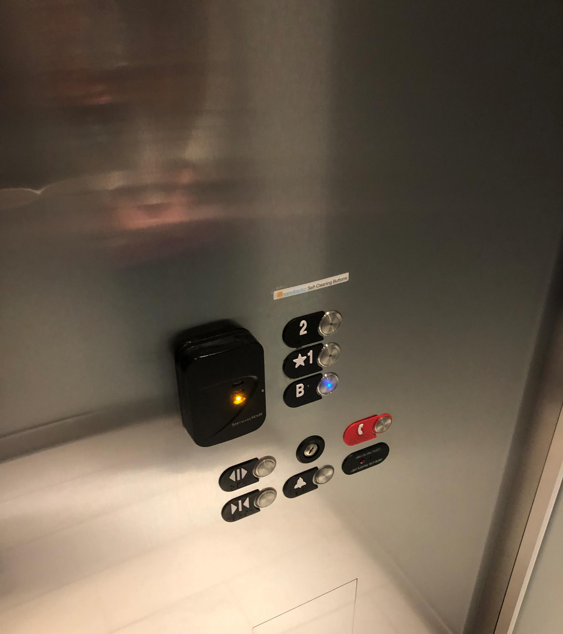
Use this elevator to go to level B

Slide 5
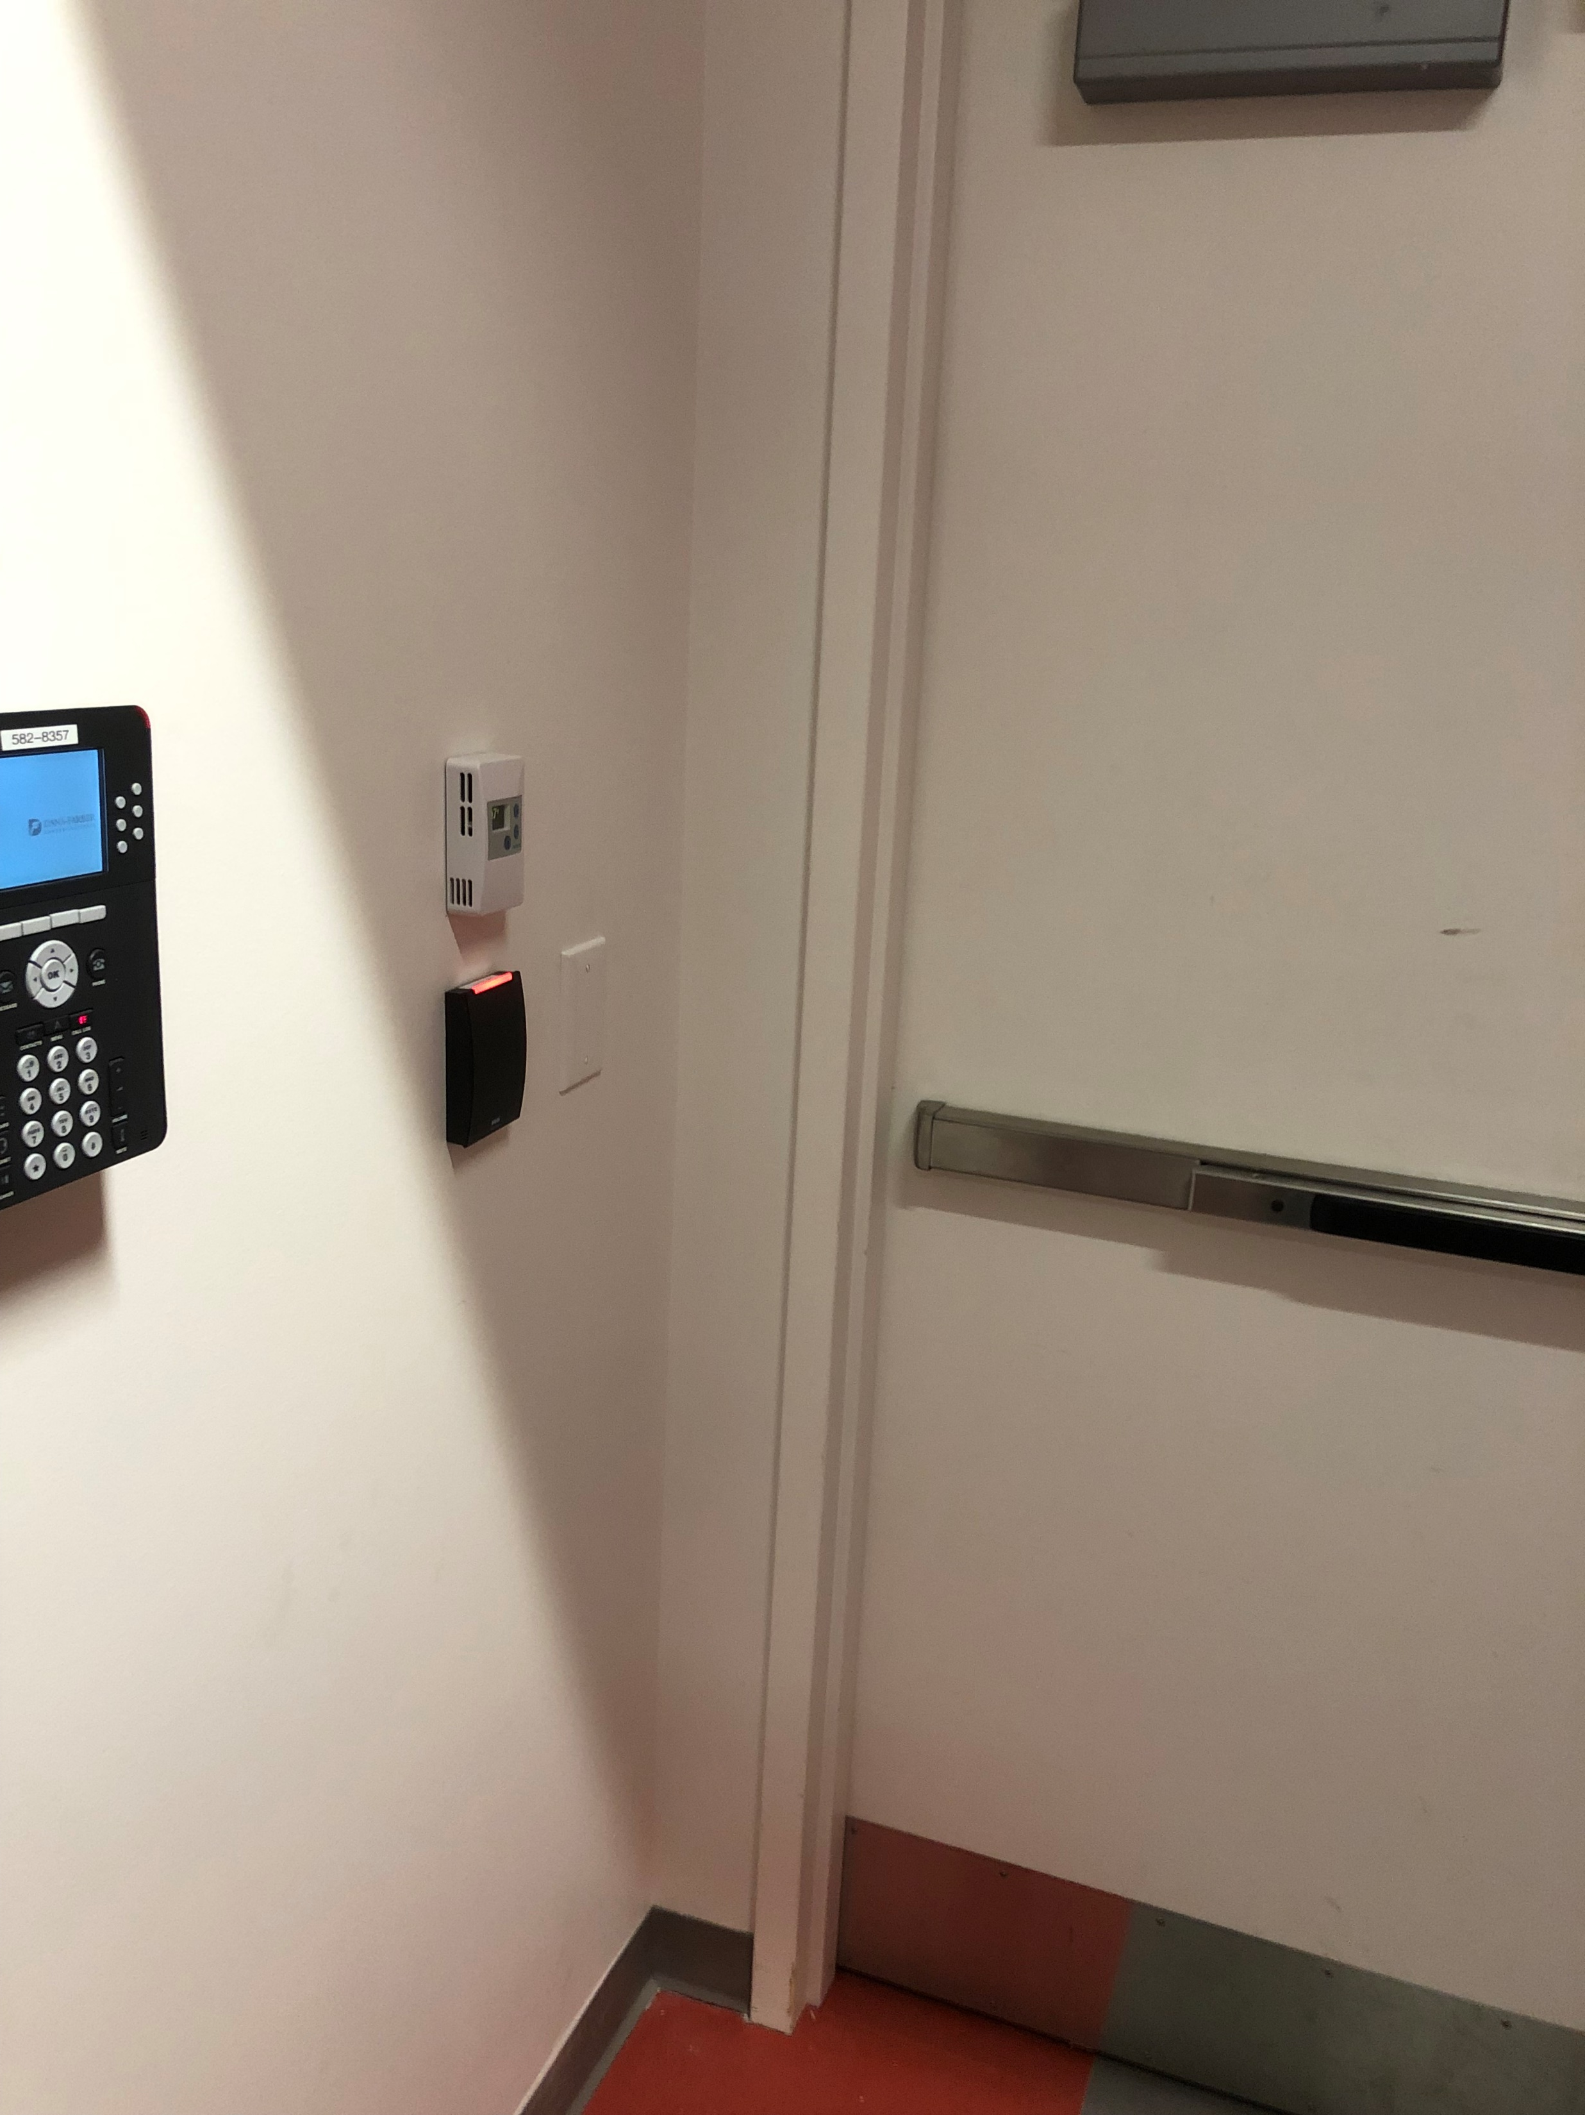
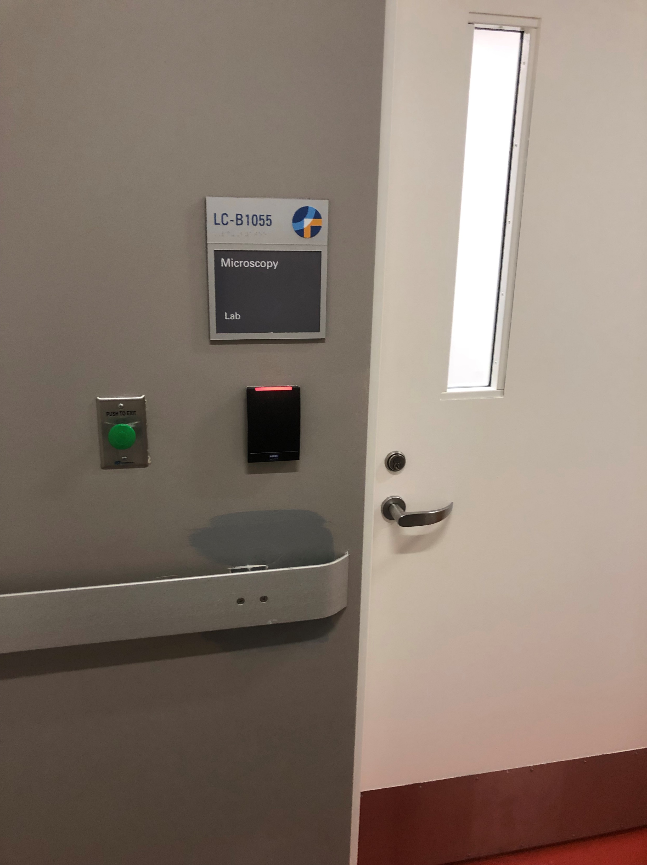
Scan your DFCI card to access
Scan your DFCI card to access the core

